Slide 1
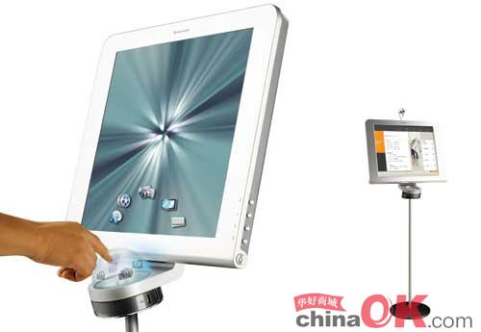
Learning about Language
The Present Perfect
Passive Voice
现在完成时的被动语态

Slide 2
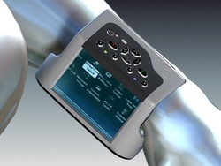
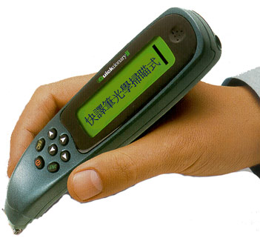
WW PC
wrist-worn/wearable PC
A wrist-worn PC has been invented recently.
A pen-like computer has already been developed.

Slide 3
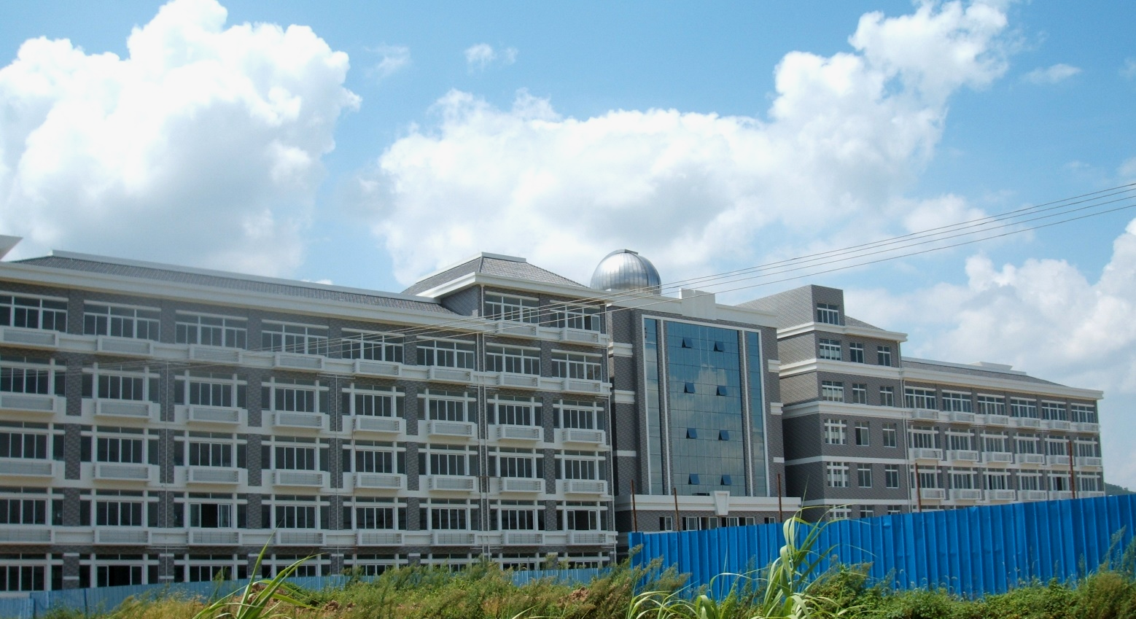
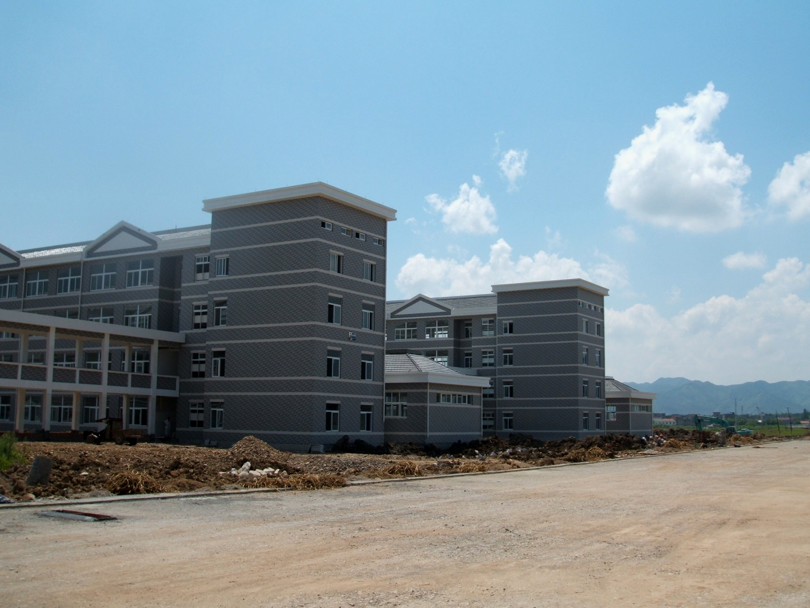
The new campus of the best high school of their city has already been built .

Slide 4
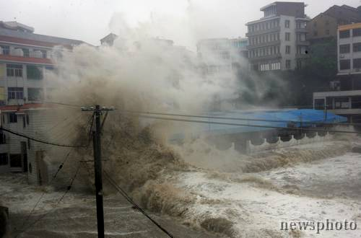
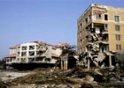
The houses have been destroyed by the storm.

Slide 5


Can you make more sentences, using
“have/has been done “?

Slide 6
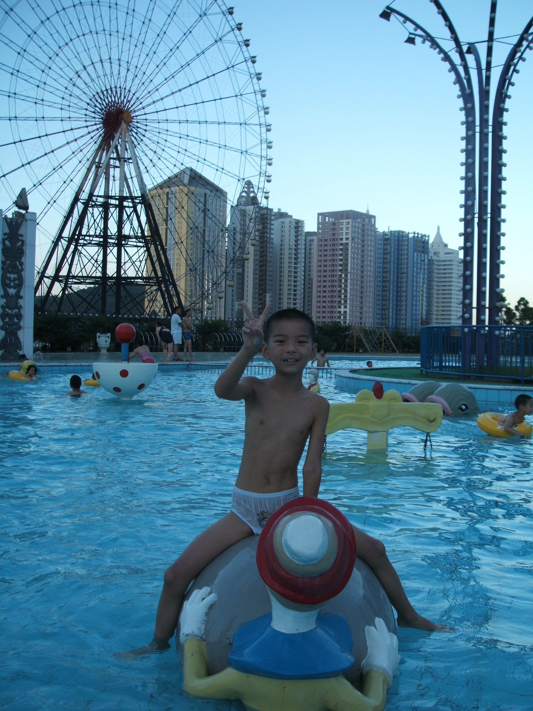
The Suntown has been set up in Hangzhou.
Many high buildings have been built there.
A big swimming pool has also been built.

Slide 7
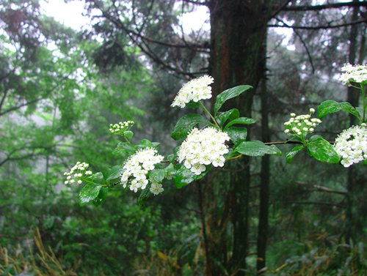
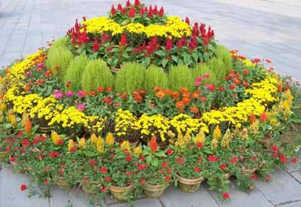
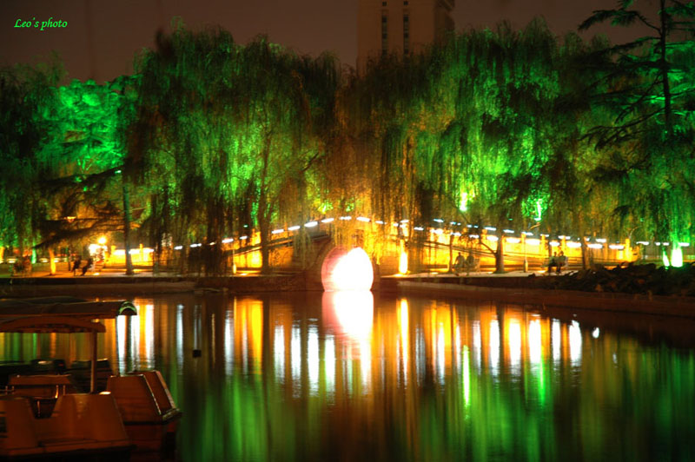
Lots of beautiful flowers and trees have been planted .
A new bridge has been completed .

Slide 8


Exercises
1. Both my brothers work at the power station that ___ in my hometown.
A. has set up B. has been set up
C. was set up D. is set up
2. ---_____ the sports meet will be put off.
A. I’ve been told B. I’ve told
C. I’m told D. I told

Slide 9
3. All the preparations for the task ____, and we’re ready to start.
A. completed
B. complete
C. had been completed
D. have been done

Slide 10
4. ---- How long ____ at this job?
---- Since 1990.
A. were you employed
B. have you been employed
C. had you been employed
D. will you be employed

Slide 11
5. When and where to go for the on-salary holiday ____ yet.
A. are not decided
B. have not been decided
C. is not being decided
D. has not been decided

Slide 12
6. That book _________into at least 20 foreign languages.
A. has said to be translated
B. has been said to have translated
C. is said that it had been translated
D. is said to have been translated
注:该句的句型是:It is said that…/people (they) said that…/that book is said to …根据句意是已经被译成了20 多种文字所以要用现在完成时的被动语态。

Slide 13
8. –Hi, Tom, you look tired.
 -- Of course. I ___ the living room all day.
A. had painted B. painted
 C. have been painted
D. have been painting

Slide 14

9. --Did you move into the new house?
-- No. The rooms ___ yet.
A. were being painted
B. are painting
C. have not painted
D. have not been painted

Slide 15
10. Great changes___ in my hometown and a lot of factories ___.
A. have been taken place;
are being set up
B. have taken place; have been set up
C. are taken place; had been set up
D. took place; will set up

Slide 16
11. It’s said that this book___ into Chinese.
A. had translated B. has translated
C. was translated D. has been translated
12. You can’t move in .The house _____.
A. is painting B. is being painted
C. has painted D. has been painted

Slide 17
13. Millions of pounds’ worth of damage___ by a storm which swept across the north of England last night. (2005重庆)
A. has been caused
B. had been caused
C. will be caused
D. will have been cause

Slide 18
14. Have you ever___ to the exhibition which ___for three weeks?
A. gone; has been shown
B. visited; shown
C. been; has been on show
D. went; lasted

Slide 19
15. ---How long ago ___ these eggs___?
--- Perhaps 15 days.
A. will; hatch
B. did; hatch
C. were; hatched
D. have; been hatched

Slide 20


改错
1. A personal computer has bought by us.
A personal computer has been bought by us.
2. Many problems has been found with our new computer.
Many problems have been found with our new computer.

Slide 21
3. A PC has been builded the way we wanted.
A PC has been built the way we wanted.
4. Our computer just has been joined to the internet.
Our computer has just been joined to the internet.

Slide 22
5. The computer was used every day since we bought it.
The computer has been used every day since we bought it.
6. A lot of e-mails had written on the computer in the past 5 years.
A lot of e-mails have been written on the computer in the past 5 years.

